Slide 1
Secure DevOps and CI/CD: Lecture Outline
What is Devops? DevOps Lifecycle
Key principles of DevOps in SDLC
7Cs of DevOps lifecycle (Key Phases of DevOps)
Why integrate security into DevOps?
Stages of integrating security in to DevOps pipeline
Continuous integration and continuous deployment (CI/CD) security
Importance of CI/CD security
Key security challenges in CI/CD. Benefits of CI/CD security
Best practices for CI/CD security
Challenges of CI/CD security
What is DevSecOPs?
DevSecOps best practices

Slide 2
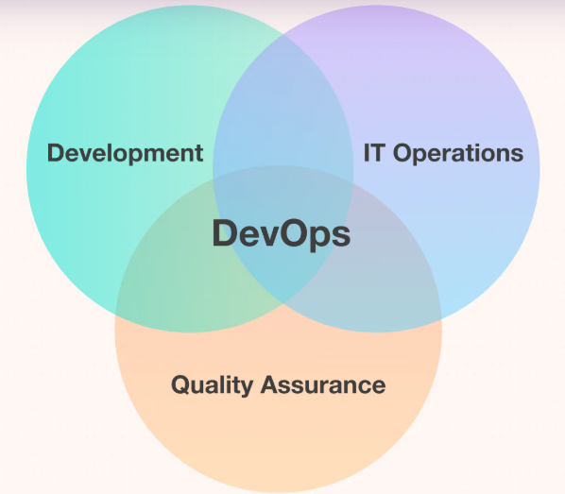
What is DevOps?
The DevOps software development life cycle (SDLC) emphasizes continuous integration, testing, delivery, and feedback, focusing on automation and collaboration between development and operations teams to accelerate software delivery and improve quality.
It was introduced to address the disconnectedness primarily between the development, operations, and quality assurance teams.

Slide 3
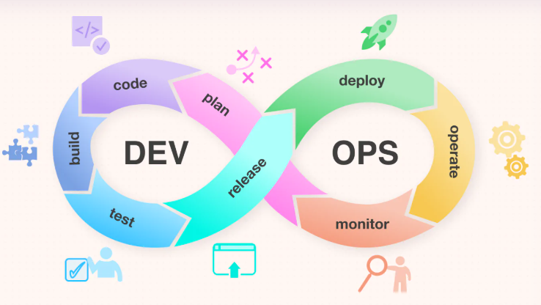
DevOps lifecycle
DevOps lifecycle is a series of automated development processes or workflows within an iterative development lifecycle.
It follows a continuous approach; hence its lifecycle is symbolized in the form of an infinity loop.
This loop depicts the collaborative and iterative approach throughout the application lifecycle, consisting of tools and technology stacks for each stage.
The left part deals with software development and testing. And in contrast, the right side of the infinity loop represents the deployment and operations cycle.

Slide 4
Key Principles of DevOps in SDLC
1. Collaboration: Breaks down silos between development and operations teams.
2. Automation: Automates repetitive tasks like testing, deployment, and monitoring.
3. Continuous Everything: CI/CD, continuous testing, and continuous monitoring ensure rapid and reliable delivery.
4. Infrastructure as Code (IaC): Treats infrastructure setup as code, enabling version control and reproducibility.
5.Feedback Loops: Ensures quick feedback from operations to development for continuous improvement.

Slide 5
Infrastructure as Code (IaC)
Infrastructure as Code (IaC) is a method of managing and provisioning IT infrastructure using code, enabling automation and consistency in infrastructure deployments, similar to how software development teams manage their code.
IaC treats infrastructure resources (like servers, networks, and storage) as code, defining them in configuration files rather than through manual configuration or graphical interfaces.
IaC helps DevOps teams test applications in production-like environments early in the development cycle.
For example, Terraform is an IaC tool that allows engineers to define their software infrastructure in code.

Slide 6
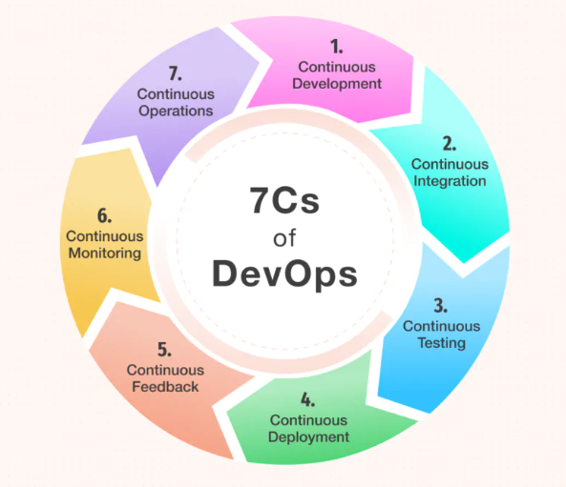
7Cs of DevOps lifecycle (Key phases of DevOps)

Slide 7
Key phases of DevOps
1. Continuous Development:
This phase involves planning, coding, and breaking down the development process into smaller cycles to facilitate faster and more agile development.
2. Continuous Integration:
Developers frequently integrate code changes into a shared repository, and automated builds and tests are run to detect issues early.
3. Continuous Testing:
Automation is used to run various tests (unit, integration, functional, performance) to ensure that new code changes don't introduce regressions or negatively impact the application's functionality.
4. Continuous Delivery/Deployment:
Software changes are automatically and consistently delivered to production or staging environments after passing through an automated build, test, and validation process.

Slide 8
Key phases of DevOps
5. Continuous Monitoring:
The performance and behavior of software applications, servers, and infrastructure components are continuously observed, measured, and analyzed to maintain a reliable and responsive IT environment.
6. Continuous Feedback:
Feedback loops are established to gather insights from users, developers, and operations teams to identify areas for improvement and optimize the software development process.
7. Continuous Operations:
This phase focuses on the ongoing maintenance, monitoring, and optimization of the software and infrastructure to ensure smooth and efficient operation.
DevOps has established a new culture in the software development industry by ensuring the highest quality standards for software products.
The key objective of the DevOps lifecycle is to maintain continuity and optimize automation.

Slide 9
Why Integrate Security into DevOps?
1. Shift-Left Security: Address security issues earlier in the development process to reduce costs and risks.
2. Continuous Security: Ensure security is continuously monitored and enforced throughout the pipeline.
3. Compliance: Meet regulatory and compliance requirements more effectively.
4. Collaboration: Foster collaboration between development, operations, and security teams.

Slide 10
Stages of Integrating Security into the DevOps Pipeline

Slide 11
Stages of Integrating Security into the DevOps Pipeline
1. Planning and Design
2. Development
3. Testing
4. Deployment
5. Operations and Monitoring
6. Maintenance and Feedback

Slide 12
Stages of Integrating Security into the DevOps Pipeline
1. Planning and Design
Threat Modelling: Identify potential security threats and vulnerabilities during the design phase.
Security Requirements: Define security requirements and compliance standards (e.g., GDPR, HIPAA).
Secure Architecture: Design the system with security in mind, such as using zero-trust architecture or secure APIs.

Slide 13
Stages of Integrating Security…
2.Development
Static Application Security Testing (SAST): Analyze source code for vulnerabilities during development.
Tools: SonarQube, Checkmarx, Fortify.
Secure Coding Practices: Train developers on secure coding standards (e.g., OWASP Top 10).
Secrets Management: Use tools like HashiCorp Vault or AWS Secrets Manager to securely manage API keys, passwords, and certificates.

Slide 14
Stages of Integrating Security…
3. Testing
Dynamic Application Security Testing (DAST): Test running applications for vulnerabilities.
Tools: OWASP ZAP, Burp Suite.
Interactive Application Security Testing (IAST): Combine SAST and DAST for real-time vulnerability detection.
Container Security: Scan container images for vulnerabilities using tools like Anchore or Clair.
Infrastructure as Code (IaC) Security: Scan IaC templates (e.g., Terraform, CloudFormation) for misconfigurations.
Tools: Checkov, Terrascan.

Slide 15
Stages of Integrating Security…
4. Deployment
Continuous Integration/Continuous Delivery (CI/CD) Security:
Integrate security tools into the CI/CD pipeline to automate security checks.
Tools: Jenkins, GitLab CI/CD, Azure DevOps.
Immutable Infrastructure: Use immutable infrastructure to reduce the risk of configuration drift.
Canary Deployments: Roll out changes to a small subset of users to detect security issues early.

Slide 16
Stages of Integrating Security…
5. Operations and Monitoring
Runtime Protection: Monitor applications and infrastructure for suspicious activity.
Tools: Falco, Sysdig, AWS GuardDuty.
Vulnerability Management: Continuously scan for vulnerabilities in production environments.
Incident Response: Automate incident detection and response using Security Information and Event Management (SIEM) tools.
Tools: Splunk, ELK Stack, IBM QRadar.
Logging and Auditing: Maintain detailed logs for auditing and forensic analysis.

Slide 17
Stages of Integrating Security…
6. Maintenance and Feedback
Patch Management: Automate the patching of vulnerabilities in production.
Post-Incident Analysis: Conduct root cause analysis (RCA) of security incidents to prevent recurrence.
Continuous Improvement: Use feedback from security incidents to improve the pipeline.

Slide 18
Continuous Integration and Continuous Deployment (CI/CD) Security

Slide 19
Importance of CI/CD Security
1. Protect the Pipeline: CI/CD pipelines are attractive targets for attackers because compromising them can lead to widespread damage.
2. Ensure Code Integrity: Prevent unauthorized or malicious code from being deployed.
3. Maintain Compliance: Meet regulatory and industry standards for secure software development.
4. Reduce Risks: Identify and mitigate vulnerabilities early in the development process.

Slide 20
Key Security Challenges in CI/CD
1. Unauthorized Access: Attackers gaining access to the pipeline.
2. Secrets Exposure: Leakage of sensitive information like API keys, passwords, or certificates.
3. Malicious Code: Introduction of malicious code into the pipeline.
4. Misconfigurations: Insecure configurations in the pipeline or infrastructure.
5. Lack of Monitoring: Inability to detect and respond to security incidents in real-time.

Slide 21
Benefits of CI/CD Security
1. Early Detection: Identify and fix vulnerabilities early in the development process.
2. Faster Remediation: Automate security checks to reduce the time to remediate issues.
3. Improved Compliance: Simplify compliance with regulatory and industry standards.
4. Enhanced Trust: Build trust with stakeholders by ensuring secure and reliable deployments.

Slide 22
Best Practices for CI/CD Security
1. Secure Access Control
2. Secrets Management
3. Code Integrity and Verification
4. Automated Security Testing
5. Secure Deployment Practices
6. Monitoring and Incident Response

Slide 23
Best Practices for CI/CD Security
1. Secure Access Control
Role-Based Access Control (RBAC): Restrict access to the CI/CD pipeline based on roles and responsibilities.
Multi-Factor Authentication (MFA): Require MFA for accessing CI/CD tools and repositories.
Least Privilege Principle: Grant users the minimum permissions necessary to perform their tasks.
2. Secrets Management
Use Secrets Management Tools: Store and manage sensitive information securely using tools like HashiCorp Vault, AWS Secrets Manager, or Azure Key Vault.
Avoid Hardcoding Secrets: Never hardcode secrets in source code or configuration files.
Rotate Secrets Regularly: Periodically update secrets to reduce the risk of exposure.

Slide 24
Best Practices for CI/CD Security
3. Code Integrity and Verification
Code Signing: Sign code commits and artifacts to ensure their authenticity.
Peer Reviews: Require code reviews before merging changes into the main branch.
Static Application Security Testing (SAST): Analyze source code for vulnerabilities during the CI phase.
Tools: SonarQube, Checkmarx, Fortify.
4. Automated Security Testing
Dynamic Application Security Testing (DAST): Test running applications for vulnerabilities during the CD phase.
Tools: OWASP ZAP, Burp Suite.
Interactive Application Security Testing (IAST): Combine SAST and DAST for real-time vulnerability detection.

Slide 25
Best Practices for CI/CD Security
5. Secure Deployment Practices
Immutable Infrastructure: Use immutable infrastructure to reduce the risk of configuration drift.
Canary Deployments: Roll out changes to a small subset of users to detect issues early.
Blue-Green Deployments: Maintain two identical production environments to minimize downtime and risk.
6. Monitoring and Incident Response
Continuous Monitoring: Monitor the CI/CD pipeline for suspicious activity.
Tools: Prometheus, Grafana, ELK Stack.
Incident Response: Automate incident detection and response using Security Information and Event Management (SIEM) tools.

Slide 26
Tools for CI/CD Security
Secrets Management: HashiCorp Vault, AWS Secrets Manager, Azure Key Vault.
SAST: SonarQube, Checkmarx, Fortify.
DAST: OWASP ZAP, Burp Suite.
Container Security: Anchore, Clair, Trivy.
IaC Security: Checkov, Terrascan.
CI/CD Integration: Jenkins, GitLab CI/CD, Azure DevOps.
Monitoring: Prometheus, Grafana, ELK Stack.
SIEM: Splunk, IBM QRadar.

Slide 27
Challenges in CI/CD Security
Complexity: Managing security across a complex CI/CD pipeline can be challenging.
Tool Sprawl: Integrating multiple security tools can lead to complexity and overhead.
Skill Gaps: Teams may lack expertise in both DevOps and security.
Performance Overhead: Security tools can slow down the pipeline if not optimized.

Slide 28
Real-World Examples of CI/CD Security
GitLab CI/CD: Integrates SAST, DAST, and container scanning into its pipeline.
Jenkins: Supports plugins for security testing and secrets management.
Azure DevOps: Offers built-in security features like pipeline approvals and arti-fact signing.

Slide 29
What is DevSecOps ?
DevSecOps is a framework that integrates security into all phases of the software development lifecycle (SDLC), aiming to build secure applications by incorporating security practices from the earliest stages of development.
DevOps focuses on streamlining development and operations for faster, efficient software delivery, While DevSecOps builds on this approach by embedding security at every stage of the pipeline, ensuring robust protection without compromising speed.

Slide 30
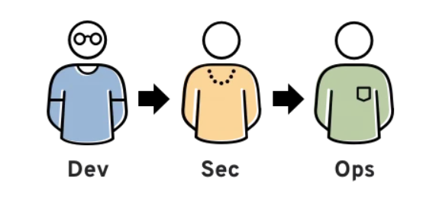
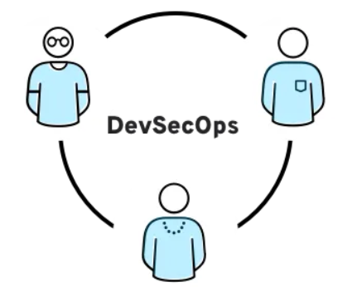
DevSecOps means thinking about application and infrastructure security from the start.
It also means automating some security gates to keep the DevOps workflow from slowing down.
Selecting the right tools to continuously integrate security, like agreeing on an integrated development environment (IDE) with security features, can help meet these goals.

Slide 31
DevSecOps Best Practices
1. Shift security left: One of the problems that DevSecOps was designed to solve was the fact that security commonly only entered the picture during the Testing phase of the SDLC. Shifting security left by integrating security into the process as early as possible helps to reduce the costs of strong security.
2. Automate where possible: Manual processes are slow and error-prone, and relying on manual security processes increases the probability that they will be ignored to speed development and release timelines.
3. Adopt security as code: Security as Code involves implementing vulnerability scanning, security policies, validations, and other security processes as code. This makes it easier to ensure that strong, consistent, and scalable security practices are implemented across the entire organization.

Slide 32
DevSecOps Best Practices
4. Integrate the Right Tools: Automating security requires access to the right tools and integration of these tools into automated CI/CD pipelines. Application security (AppSec) tools such as static application security testing (SAST), dynamic application security testing (DAST), interactive application security testing (IAST), and source composition analysis (SCA) solutions help to identify vulnerabilities early in the SDLC.
5. Share Responsibility: Collaboration between the development, security, and operations teams is one of the founding principles of DevSecOps, but it isn’t enough. An effective DevSecOps program requires buy-in and support across the entire organization, including in the C-Suite.

Slide 33
DevSecOps Best Practices
6.Communicate: A DevSecOps program thrives on eliminating 6. communication silos and building collaboration between teams. To be successful, a DevSecOps program should involve all stakeholders in key decisions and ensure that all parties prioritize security and are clear about their responsibilities.
7. Educate: While the development, security, and operations teams are the ones that are named in DevSecOps, they are not solely responsible for security, and the success of a DevSecOps program can be impacted by factors outside of their control. Education is key to ensuring that DevSecOps teams are supported and that other stakeholders properly prioritize and handle their security duties.

Slide 34
Conclusion
By implementing robust security practices in the CI/CD pipeline, organizations can ensure that their software is secure, reliable, and compliant with industry standards.
CI/CD security is not just about tools but also about fostering a culture of security awareness and collaboration across development, operations, and security teams.

